Slide 1


The Behavior Engine for Direct Selling
Segmentation
www.DirecTechLabs.com

Slide 2
Objective
CASE BACKGROUND
PM and direct selling industry is battling with high churn, specially in lower ranks and in customers with lower tenure.
PM wants to flag the high risk customers and will devise the strategies to retain them.
Understanding of main drivers of churn will help PM in devising the right strategies.
PROPOSED SOLUTION
BUSINESS IMPACT
Customer Segmentation - Separate the customers with same behavior in one group
Prediction models – Predictive models for each group to find the probability of churn
Churn Reduction will increase the customer base and improve the revenues
Homogenous segments will also be helpful in understanding the customer base and will have unquantifiable results.

Slide 3
3 step analytical framework for Churn Prediction
Segmentation – Know your customers
Identification of homogeneous customer segments
Understanding the patterns & profiles of customers in each segment
Prediction – Churn Probability of each customer
Prescriptive Analysis - Whom to Retain?
Identify the high risk customers in each clusters and target them with right strategies.
Use statistical techniques such as logistic Regression to identify customers who are most likely to churn
Identify the influencing factors for each customer.

Slide 4
Data Structure Used for the Project
Total Customer Base
1,090,349
NON Mandator , NON FIRM
1,083,865
Created before June 2016
1,088,127
Customer with either Sales, Commissions or Network Addition
518,901
Customers Created From 2012
401,985
Customer with at least 1 Euro of Sales
378,821
Customers Base
Sales Orders
Commission & Payout
Age – Only Considered Age between 20 to 70, rest of the data doesn’t look right
Mandator – Remove these customers from analysis
PayoutEur – Amount of Commission in Euros
Gender – Based on Salutation, Derive the Gender of a Customer
Document Type – Only Considered Document Type ‘O’
Calculation Date, Period – To find when and for which Period Commission has been Paid
Created Date – Used to find the starting date of a customer
Document State – Orders with document State ‘S’ has been removed
Subscriptions
Number of Customers Used for the analysis
Table and Fields Used for the analysis
Customer Network History
Order Date – For Order Creation Date
To find out the customers who have active subscriptions
Total Points GV – For Value of Orders in EURO
Sponsor , Customer Number, Start Date, End Date, Quali Level –
Used these columns to find the current Quali Level & Historical.
Used this to find the network addition, deletion of a customer
E-Business Logins
Sales Orders Details
Will use this information in Predictive Modelling
Product – Not able to structure the product information in right format

Slide 5
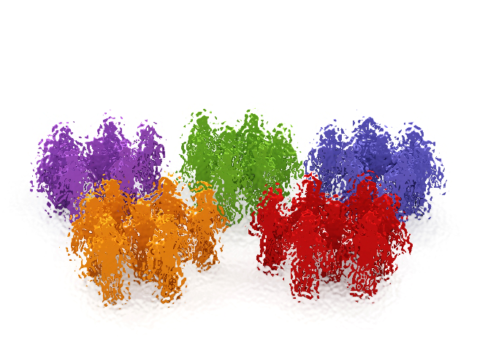





Segmentation framework will identify different persona of customers
Identifying the Dimensions
Age & Gender
Transaction History like Sales, Discount Rate
Network Growth
Subscriptions
Commissions
Rank Growth
Statistical techniques such as K-Means clustering has been used for Segmentation
Segmentation
Masters of the Trade
Performing Female Customers
Average Male Performers
Poor Female Performers
Generate High Sales
Receives Commissions
Adds Network
92% had subscriptions
Generate Avg. Sales
94% Had Subscriptions
All Place Second Order in first 6 months
Below Average Sales
70% had subscriptions
64% place second order in first 6 months
Doesn’t generate sales after one month
Profiling & Base Strategies
High Value
Medium Value
Low Value
# of Customers
67,171
134,330
96,075
81,245
% of Total
18%
35%
25%
21%

Slide 6







Segment 1 – Behavioral & Demographical Traits
Life Time Sales
Life Time Commissions
Average Life Time Sales
EUR 2,700
(Average of all customers - EUR 1,078)
Range of Top 25%
EUR 4,312 –
231,700
Average Life Time Commissions
EUR 520
(Average of all customers - EUR 95)
Range of Top 25%
EUR 423 –
681,552
Masters of the Trade
21% Germany
22 % Male Customers
Numbers of Customers 67,171
18% Sweden
% of Total Customers
18%
72 % Female Customers
10% Finland

Slide 7
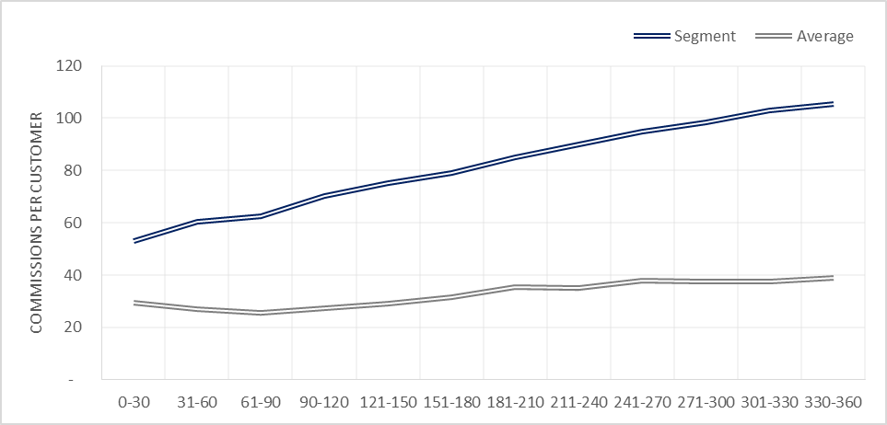
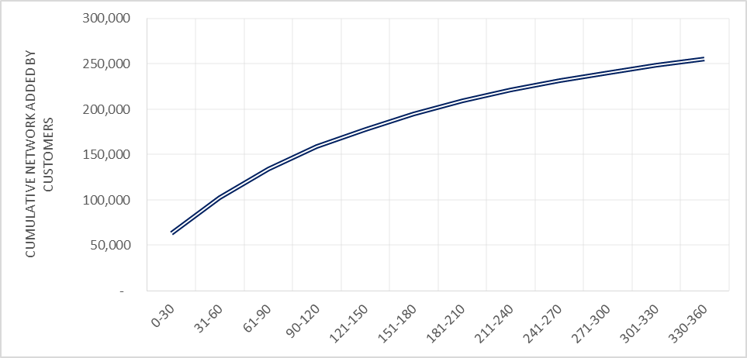
Evidence of Behavioral Traits of Segment 1 from Commissions & Network
Average Commission Per Customer
Cumulative Network Added by Customers
As can be seen from above graphs, Commissions per Customer is increasing as customer’s tenure is increasing in PM
From second graph, customers in this segment are going the extra mile to increase their network

Slide 8
Segment 2 – Behavioral & Demographical Traits
Life Time Sales
Life Time Commissions
Average Life Time Sales
EUR 1,011
(Average of all customers - EUR 1,078)
Range of Top 25%
EUR 1,223 –
19,564
Average Life Time Commissions
EUR 3
(Average of all customers - EUR 95)
Range of Top 25%
EUR 93 –
2,509
Valuable Female Customers
24% Germany
0 % Male Customers
Numbers of Customers 134,330
25% Sweden
% of Total Customers
35%
99 % Female Customers
15% Finland

Slide 9
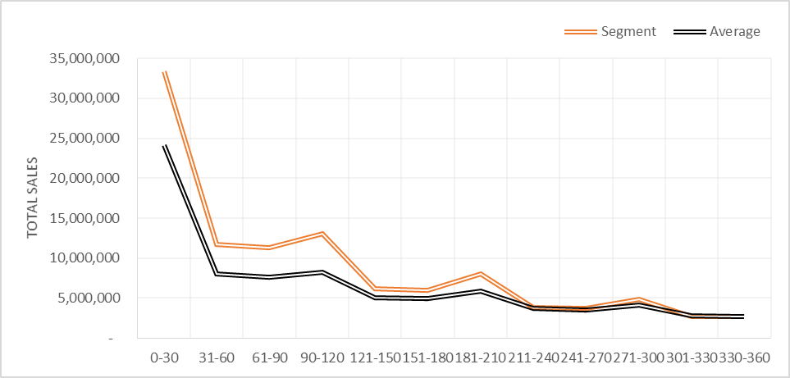
Evidence of Behavioral Traits of Segment 2
Customers in this segment does above average sales and completely outperforming the average customers.

Slide 10
Segment 3 – Behavioral & Demographical Traits
Life Time Sales
Life Time Commissions
Average Life Time Sales
EUR 751
(Average of all customers - EUR 1,078)
Range of Top 25%
EUR 900 –
28,807
Average Life Time Commissions
EUR 5
(Average of all customers - EUR 95)
Range of Top 25%
EUR 60 –
2,049
Average Male Performers
32% Germany
99 % Male Customers
Numbers of Customers 96,075
% of Total Customers
25%
16% Sweden
0 % Female Customers

Slide 11
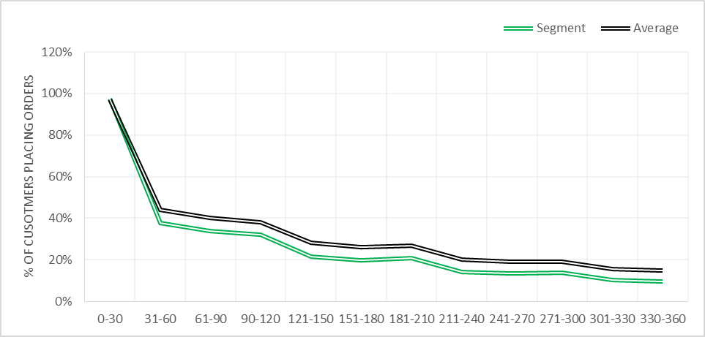
Evidence of Behavioral Traits of Segment 3
Performance of Customers in this segment is tad below average performance in terms of sales and orders.
Only 10% of total customers are placing orders after a year.

Slide 12

Segment 4 – Behavioral & Demographical Traits
Life Time Sales
Life Time Commissions
Average Life Time Sales
EUR 239
(Average of all customers - EUR 1,078)
Range of Top 25%
EUR 290 –
1423
Average Life Time Commissions
EUR 0
(Average of all customers - EUR 95)
Range of Top 25%
EUR 26 –
485
Poor Female Performers
36% Germany
0 % Male Customers
Numbers of Customers 81,245
% of Total Customers
21%
10% Italy
96 % Female Customers

Slide 13
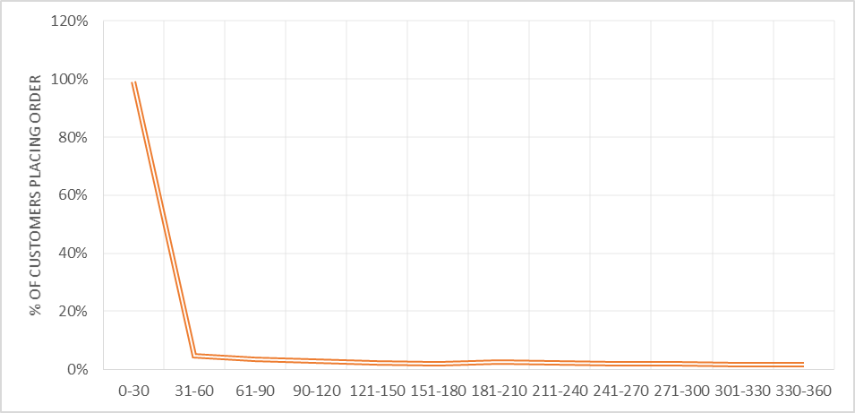
Evidence of Behavioral Traits of Segment 4
95% doesn’t place second order ; Only 5% customers in this segment place order after 30 days

Slide 14
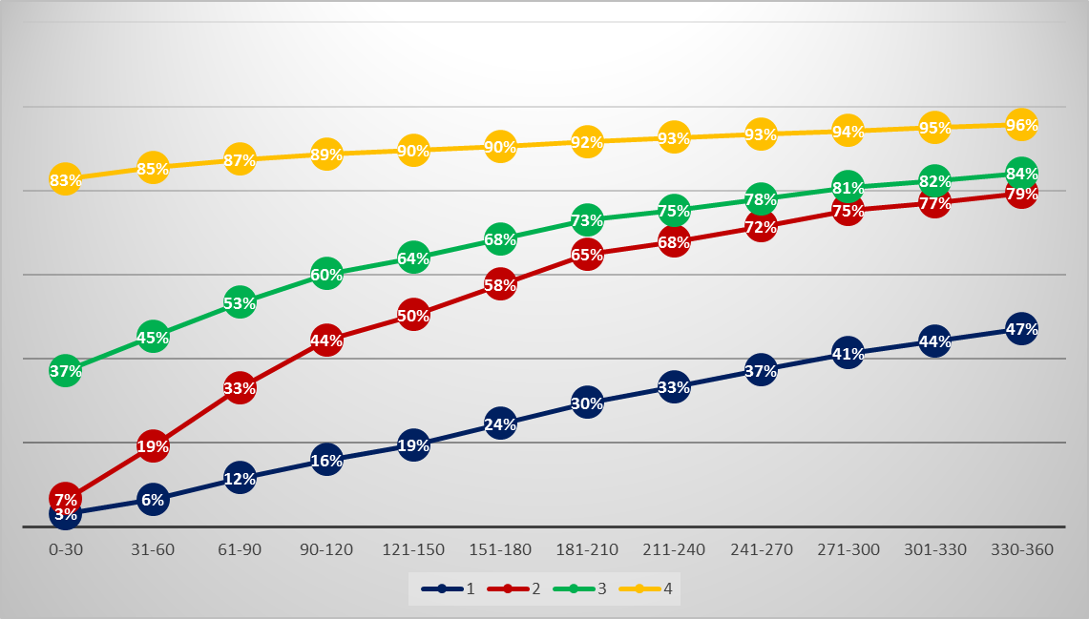
Churn Profiling
37% customers in this segment didn’t do any activity after 30 days
Customers who didn’t do any activity in 60 days will be considered as Churned

Slide 15
Appendix

Slide 16
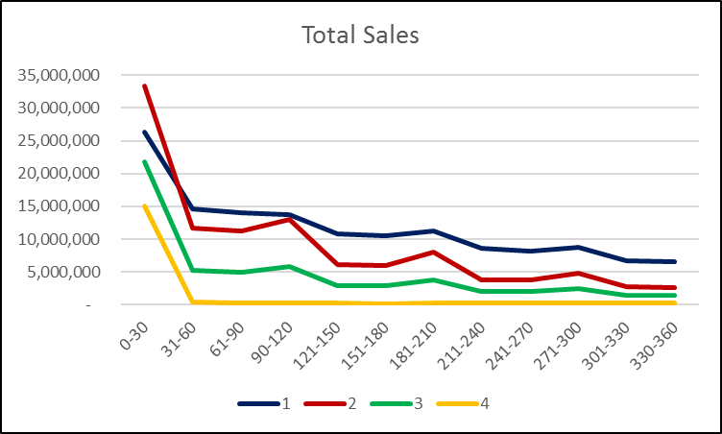
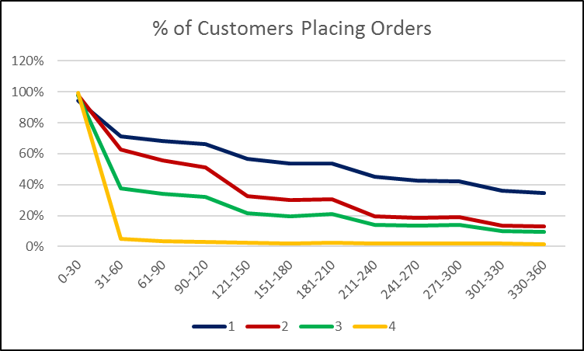
Evidence of Behavioral Traits from Sales & Order
Sales & Orders for cluster 4 is almost approaching 0 after 1 month
Cluster 2 has more sales and orders in 0-30 days than cluster 1 but then it start decreasing after 1 month
Notice the bump in sales in cluster 2 after three months and six months

Slide 17
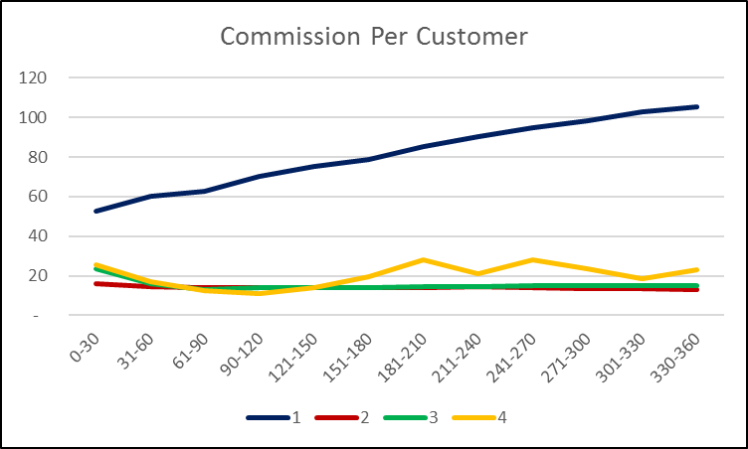
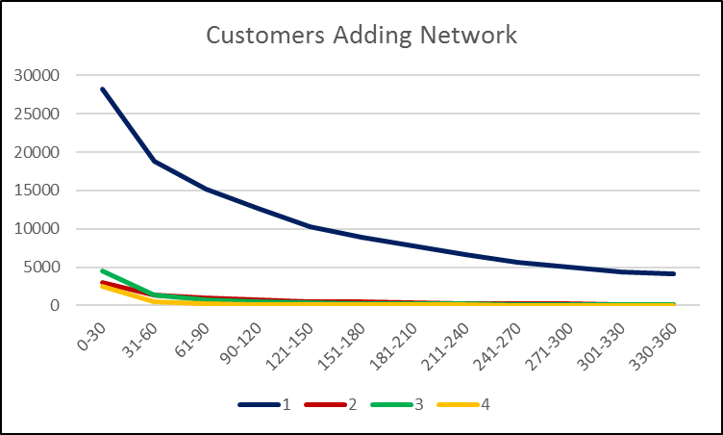
Evidence of Behavioral Traits from Commission & Network Expansion
Commission per customer in cluster 1 is growing as they are spending more time in the business. Working hard to expand their network.
Rest of the clusters are just not able to grow their business or not thinking at all about earning extra bucks
Some members of cluster 1 is going out of their comfort zone and adding customers after a year also.
Rest of the clusters gave up completely to grow their business.

